Slide 1
RladiesItaly
library(dplyr)
rladies_global %>%
filter(country == ‘Italy')
Text mining e data analisi con twitter: casi pratici di estrazione e trattamento dati

Slide 2
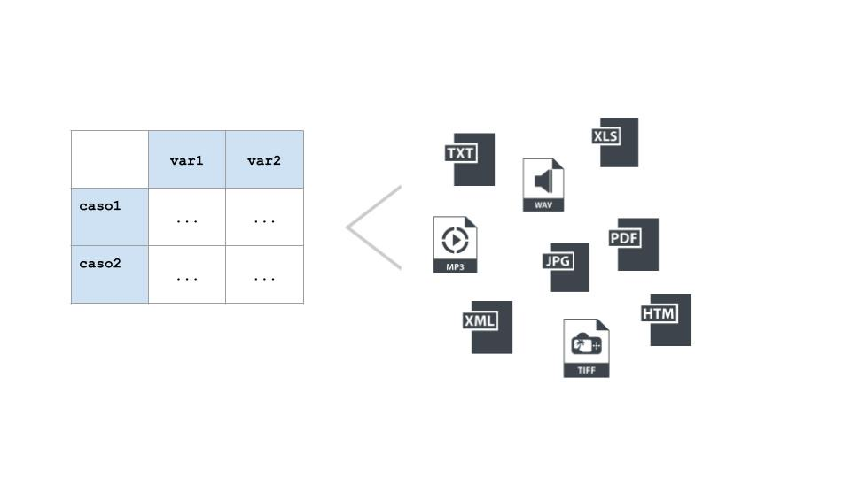
Dati non strutturati

Slide 3
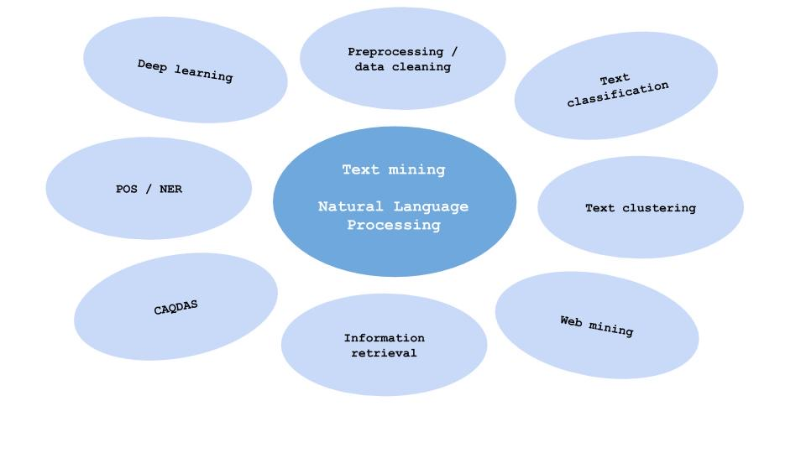

Slide 4
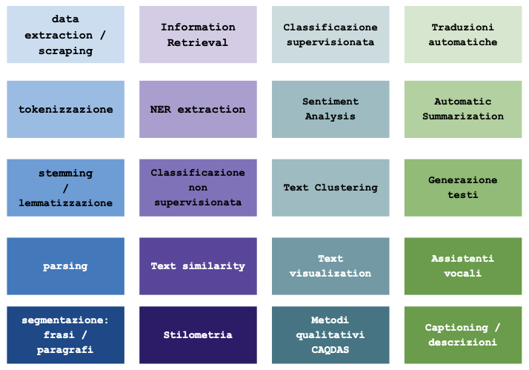

Slide 5
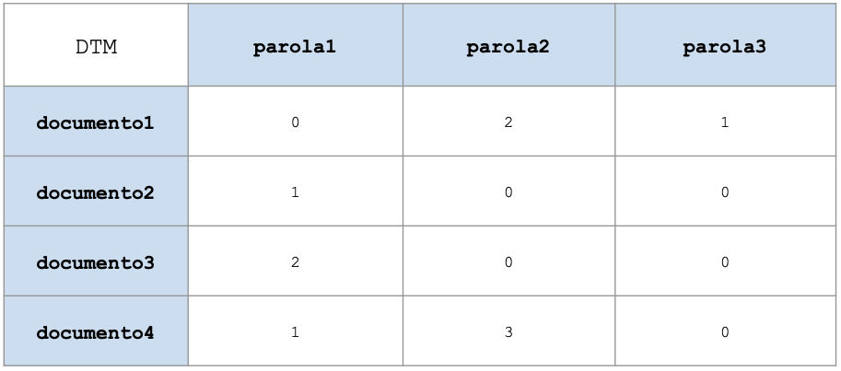
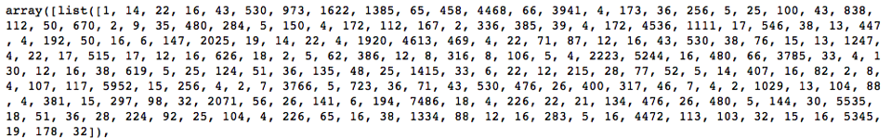
Classificazione
Generazione

Slide 6
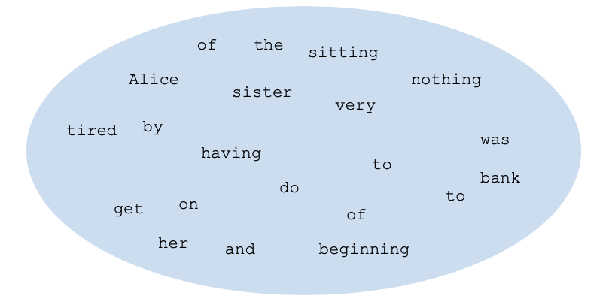
“Alice was beginning to get very tired of sitting by her sister on the
bank, and of having nothing to do…”

Slide 7
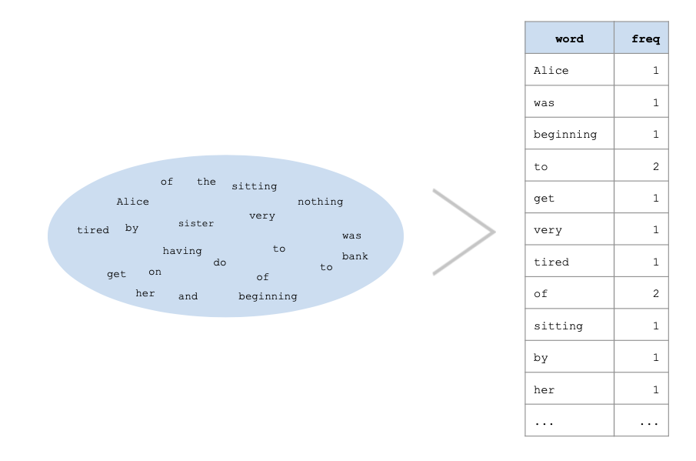

Slide 8
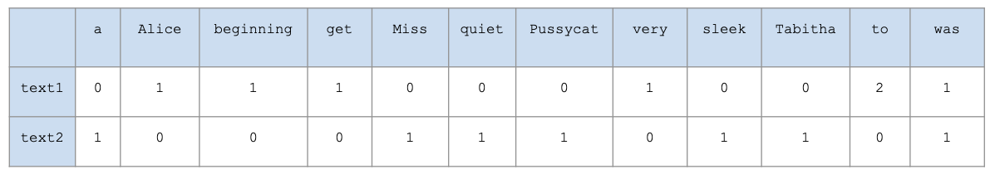

Slide 10


Slide 11


Slide 12
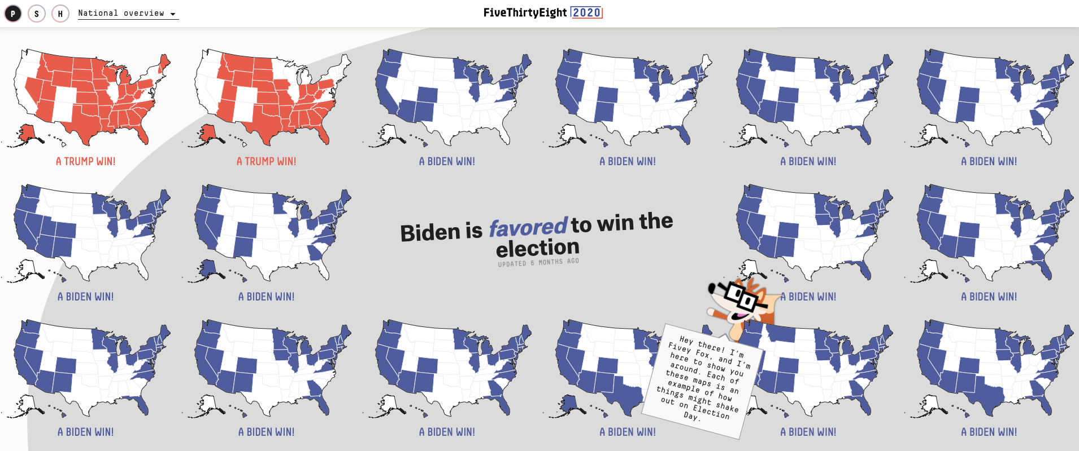

Slide 13
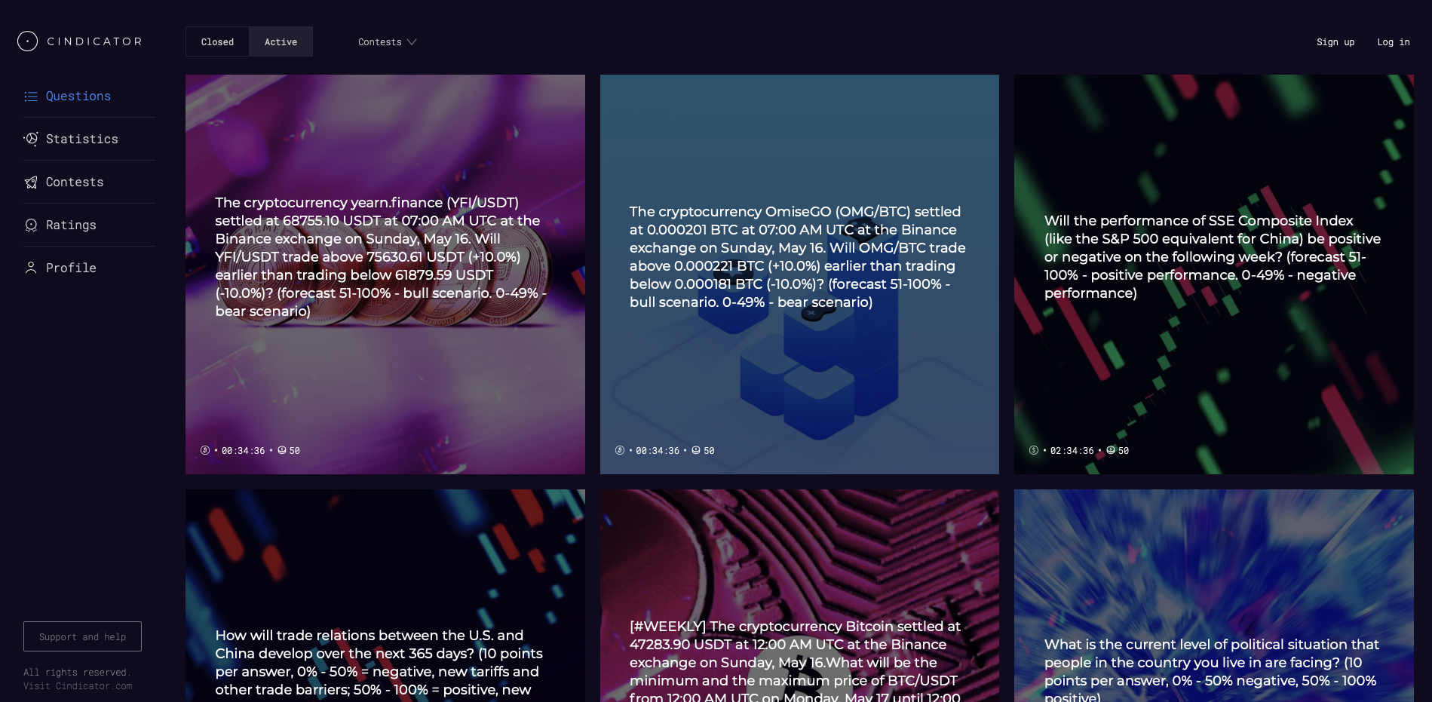

Slide 14
